Slide 1
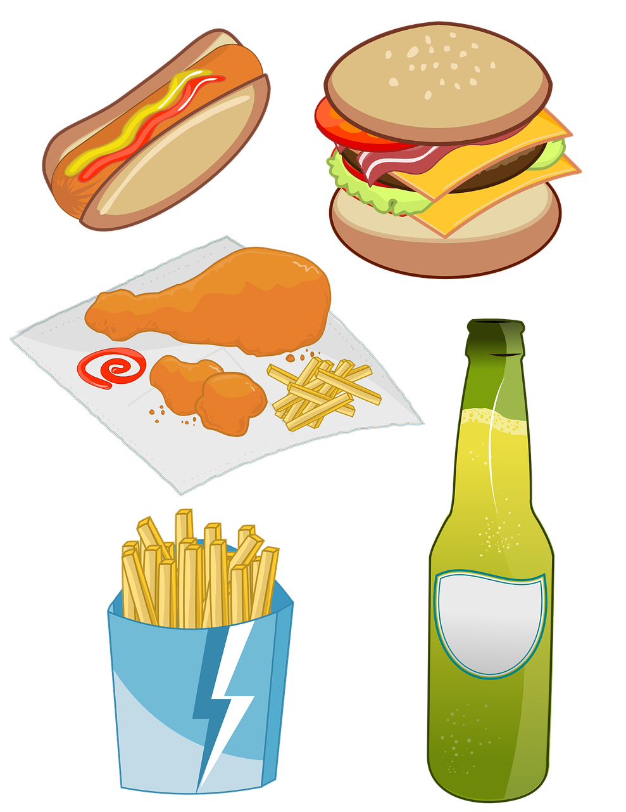



Classification of Processed Food

Slide 2
Class Activity

Slide 3

Minimally processed

Slide 4
Processed for preservation

Slide 5
Minimally processed

Slide 6
Mixtures of combined ingredients (e.g Packaged mixes, jarred sauce and Mixtures, home prepared)

Slide 7
“Ready-to-eat” foods (e.g Packaged ready-to-eat foods and Mixtures, store prepared)

Slide 8
Prepared foods/meals

